Slide 1
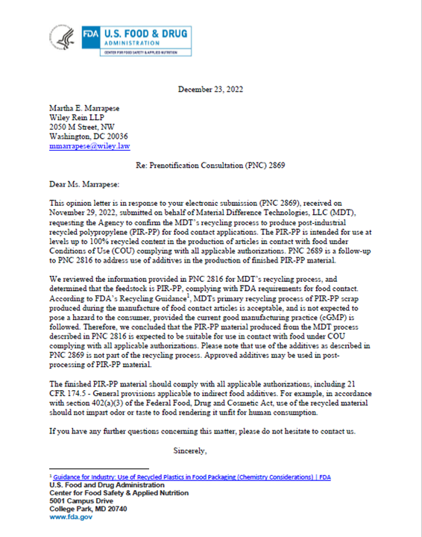

Slide 2

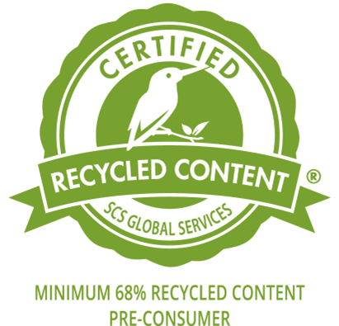
Material Difference Technologies Committed to Sustainability and Quality
Phoenix Pro Certified PCR-PP
FDA Grade Certified PIR-PP
Post-Consumer recycled plastic material
Natural, Black & White Repro Grades
Certified by AM Testing & Services, an ISO/IEC 17025:2017 laboratory
PhoenixPro PCR-PP meets requirements of ISOº14021:2016
Association of Plastic Recyclers (APR) PCR Certification Program
Continuing certification based upon quarterly data submissions to AM Testing laboratory
Verified FDA PNC Letter
Food contact articles approved
Approved up to 100% recycled content
Approved additives allowed
Conditions of Use A – J approved
Available Grades Include:
FDA 2020 PIR, Natural
FDA 4010 PIR, Natural
FDA 4020 PIR, Natural
FDA 6020 PIR, Natural
Your Spec too!
2-sided Handout – Page 1 of 2

Slide 3

Material Difference Technologies Committed to Sustainability and Quality
Replas ReNew PIR-PP
Bromley ReNew PIR-PP
A wide range of Extruded grades
Available with Certified recycled content.
Custom compounding
Natural & Black colors
Multiple logistics options
Bulk Truck
Super Sacks
Gaylord Box delivery.
A wide range of Extruded grades
Multiple material conversion options
Custom compounding
Black, White & Mixed color options
Multiple logistics options
Bulk Truck
Super Sacks
Gaylord Box delivery.
2-sided Handout – Page 2 of 2

